Slide 2
Architecting Multi Cloud Ready applications
Swaminathan Vetri
Senior Solution Architect – Maersk Technology Center

Slide 3
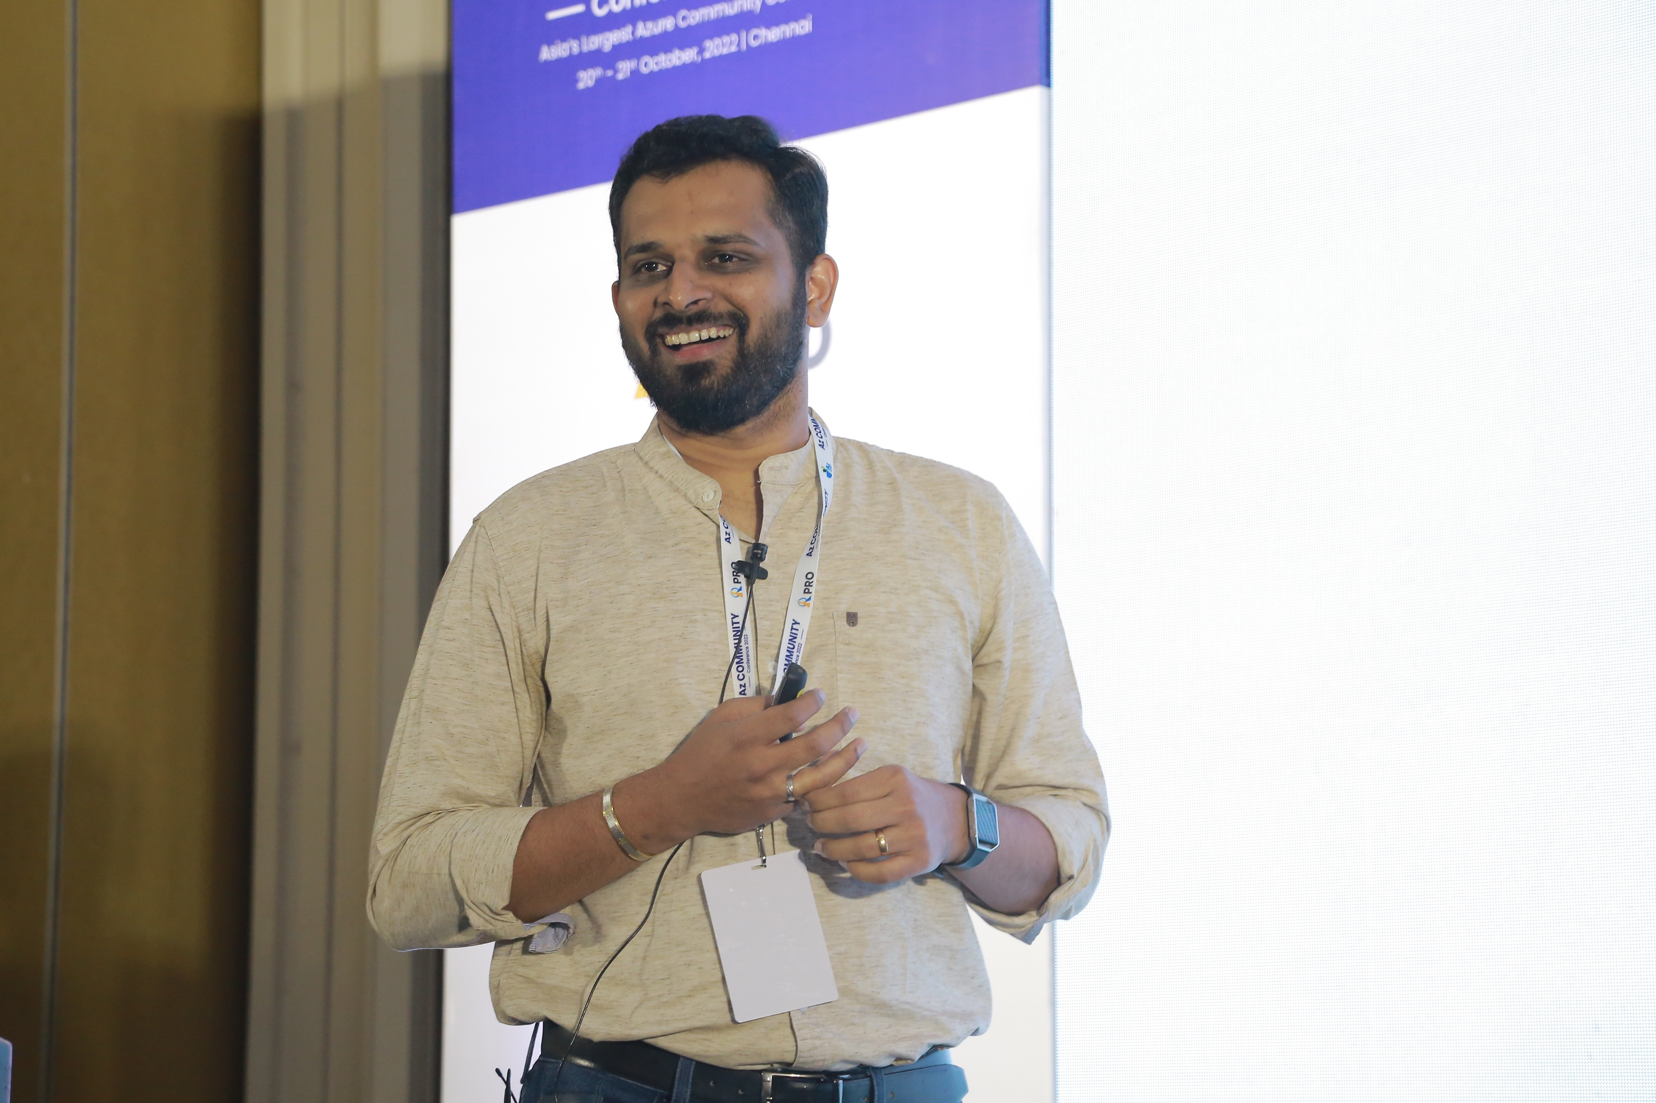
About Me
Dad of 2 little princess ☺
Senior Solution Architect @ Maersk Technology Center
Building Next gen, Modern Order management platform
Cloud Native, Kubernetes, Azure, Microservices, DevOps, Java, .NET
Organiser of .NET and Azure user groups in Bangalore
GitHub/LinkedIn/Instagram/YouTube - @swaminathanvetri
Twitter - @svswaminathan
Blogging, Public speaking, Traveling, Photography, Dance, Table Tennis, Home automation

Slide 4
Agenda
What are Multi cloud applications?
Why Multi Cloud ?
Architectural choices for multi cloud ready apps
Tools & Technologies that enables multi cloud

Slide 5
What is Multi-cloud?
Multi-cloud refers to using services from more than one public cloud provider at the same time.
A multi-cloud environment allows your cloud environments to be private, public, or a combination of both.
The primary goal of a multi-cloud strategy is to give you flexibility to operate with the best computing environment for each workload.

Slide 6
Hybrid Cloud vs Multi-Cloud?
Hybrid Cloud
Common workloads are deployed across Private and Public cloud
Combines Private Cloud (on-premise Datacenter) with Public Cloud (Azure, AWS, GCP etc.,)
Multi-Cloud
Using cloud computing service from more than one public cloud for different workloads
Interconnects different services across clouds and without having to connect the clouds themselves

Slide 7
Why Multi-cloud?
Leverage Best of each cloud
Avoids Vendor lock in
Cost efficiency
Innovative Technology
Advanced security and regulatory compliance
Increased reliability and resiliency
Increased performance

Slide 8
Common use cases
Disaster recovery
Avoids Single point of failure
Better latency Globally
Deploy apps to servers nearby to your user's locations in any cloud
Ability to switch across clouds to stay compliant
Regional requirements
Shadow IT
Provides teams with approved set of cloud providers to avoid usage of unsanctioned services

Slide 9
Types of Multi-cloud applications
Multi-cloud enterprises
Deployed one app to one cloud and another to a different cloud
Cloud-agnostic applications
Same applications are deployed to different clouds
Multi-cloud application
Single application distributed across multiple clouds
High
Low

Slide 10
Every other company does it 😁
Why should you go Multi-cloud ???
FOMO!!!

Slide 11
Multicloud usage stats
85%
Orgs deploy apps on two or more IaaS providers
87%
Orgs agrees app env will be distributed across multiple locations
88%
Orgs agrees multiple cloud providers delivers strategic benefits
Source: esg_ebook_google_cloud_multicloud_application_deployment_february_2023.pdf

Slide 12
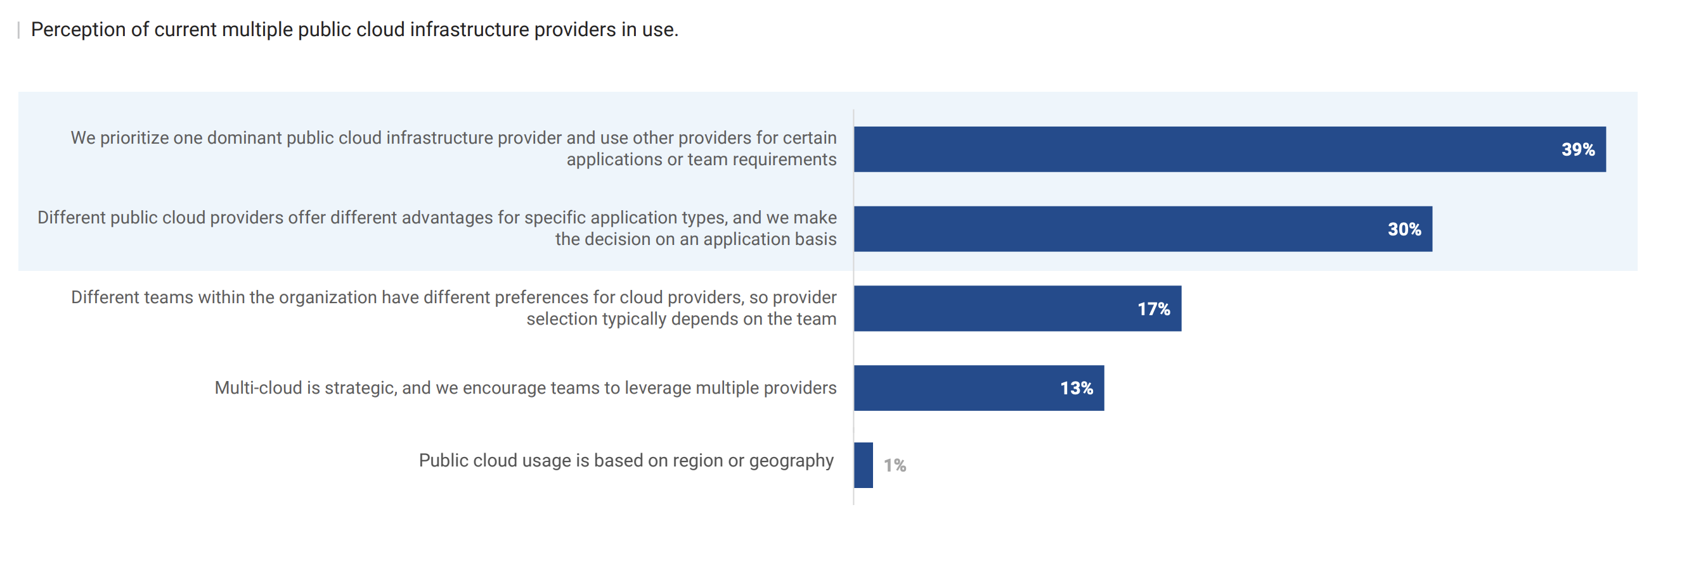
Multicloud usage stats
Source: esg_ebook_google_cloud_multicloud_application_deployment_february_2023.pdf

Slide 13
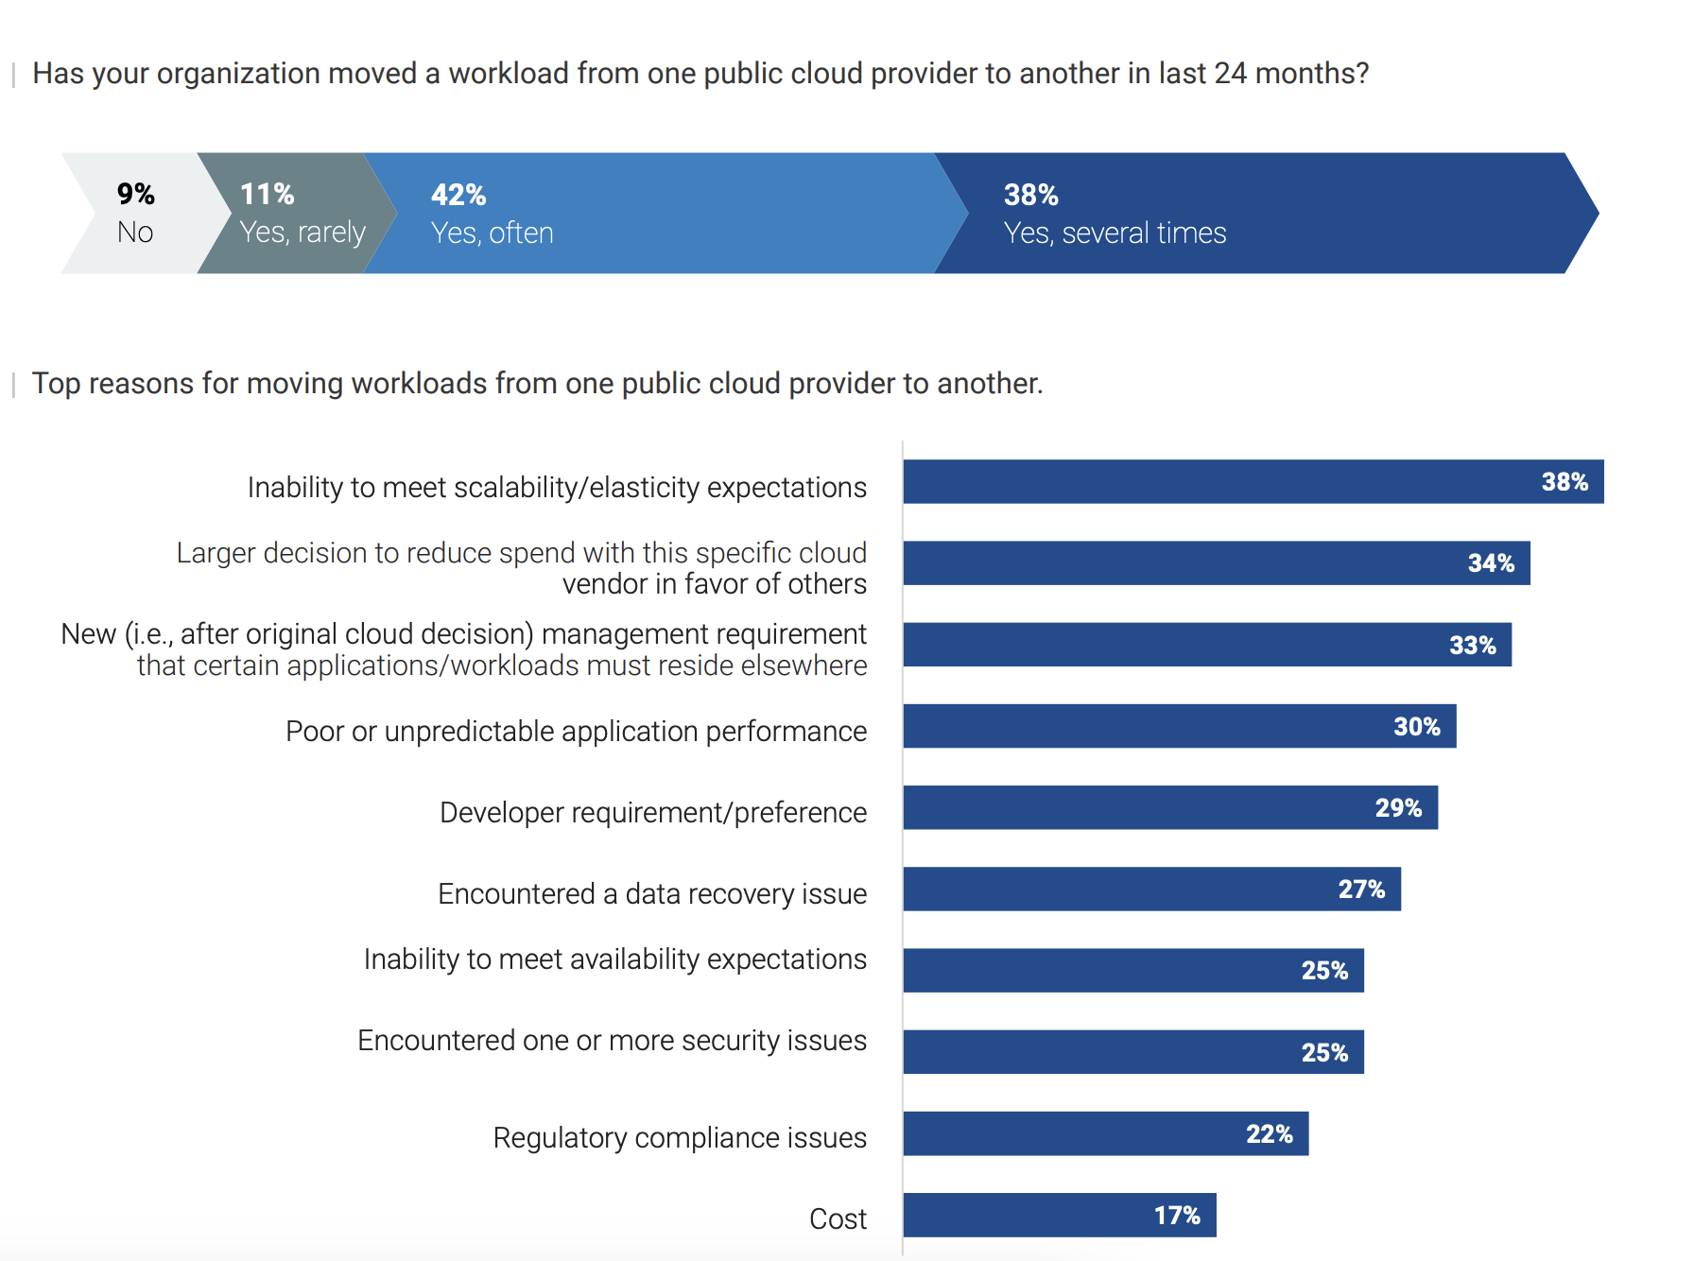
Multicloud usage stats
Source: esg_ebook_google_cloud_multicloud_application_deployment_february_2023.pdf

Slide 14
Multi-cloud Architectural choices
Cloud-agnostic applications
Same applications are deployed to different clouds

Slide 15
Simplified Cloud solution architecture
Application workloads
Identify and
Access management
Infrastructure management
Databases
Observability
Security
Hosting Infrastructure
(IaaS/PaaS/Containers)
Governance

Slide 16
Hosting Infrastructure
Azure | AWS | GCP
Azure Virtual Machines | Amazon EC2 | Compute Engine
Azure VM Scale sets | AWS Auto scaling | Compute Engine Auto scaler
Azure Batch | AWS Batch | Batch
Azure Container Apps | Amazon Elastic Container Service (ECS) | Cloud Run
Azure Kubernetes Service (AKS) | Amazon Elastic Kubernetes Service (EKS) | Kubernetes Engine (GKE)
Azure Functions | AWS Lambda | Cloud Functions
IaaS
PaaS
Serverless
Managed k8s (PaaS)
Self managed (Iaas)
Serverless Container runtimes (CaaS)
More Control
More Flexibility

Slide 17
Networking
Azure | AWS | GCP
Virtual Network | Virtual Private Cloud (VPC) | Virtual Private Network
Azure NAT Gateway | NAT Gateways | Cloud NAT
Azure Load Balancer | Network Load Balancer | Cloud Load Balancer
Azure Traffic Manager | Route 53 | Global Cloud Load Balancer
Azure Private Link | AWS Private Link | Private Service Connect

Slide 18
Application Workloads
Azure | AWS | GCP
Azure App Service | Elastic Beanstalk | App Engine
Azure Functions | AWS Lambda | Cloud Functions
Static Web Apps | AWS Amplify | App Engine
API Management - API Gateway/Azure API Management / Apigee
Container runtimes – Azure Container Apps/Elastic Container service/Cloud Run
Container Orchestration - Azure Kubernetes Service/Elastic Kubernetes Service/Google Kubernetes Engine

Slide 19
Messaging/Eventing services
Azure | AWS | GCP
Azure Event Grid | Amazon Event Bridge | Cloud Pub/Sub
Azure Service Bus | Amazon Simple Notification Service (SNS) | Cloud Pub/Sub
Azure Event Hubs | Amazon Kinesis | Cloud Pub/Sub
Managed Kafka/Active MQ/Rabbit MQ | Managed Kafka
Notes:
Application runtimes
Messaging & eventing services

Slide 20
Databases
Azure | AWS | GCP
Azure Cosmos DB | Dynamo DB | Cloud Spanner
Azure Cosmos DB - No SQL API - Table storage | - Simple DB | - Cloud BigTable
Azure Cosmos API for Mongo | Amazon Document DB | Cloud Firestore
Azure Cosmos API for Cassandra | Amazon Keyspaces | NA
Azure Database for MariaDB | RDS for MariaDB | NA
Azure SQL/RDS for SQL Server/Cloud SQL for SQL Server | RDS for SQL Server | Cloud SQL for SQL Server
Azure Database for MySQL/RDS for MySQL/Cloud SQL for MySQL | RDS for MySQL | Cloud SQL for MySQL
Azure Database for PostgresQL/RDS for Postgres/Cloud SQL for Postgres/AlloyDB | RDS for Postgres | Cloud SQL for Postgres
Mongo DB Atlas
Notes:
GCP has Datastax Cassandra via Market place
GCP has Neo4J Aura via Market place

Slide 21
Observability
Azure | AWS | GCP
Azure Monitor | Amazon Cloud Watch | Operations
Application Insights | X-Ray | Cloud Trace/Cloud Profiler
Azure Log Analytics | Cloud Watch | Cloud Logging
Managed Service for Prometheus
Notes:
- Add Application monitoring using LGTM stack

Slide 22
DevOps Tools
Azure | AWS | GCP
Azure DevOps Azure Repos Azure Pipelines Azure Artifacts | Code Commit Code Build Code Pipeline Code Deploy | Cloud Source Repositories Cloud Build
Azure Resource Manager | Cloud Formation | Cloud Deployment Manager
Azure CLI | AWS CLI | Gcloud CLI
CI/CD : GitHub Actions/GitLab/Other Cloud agnostic DevOps tools
IaC: Terraform/Pulumi/Chef/Puppet/Ansible

Slide 23
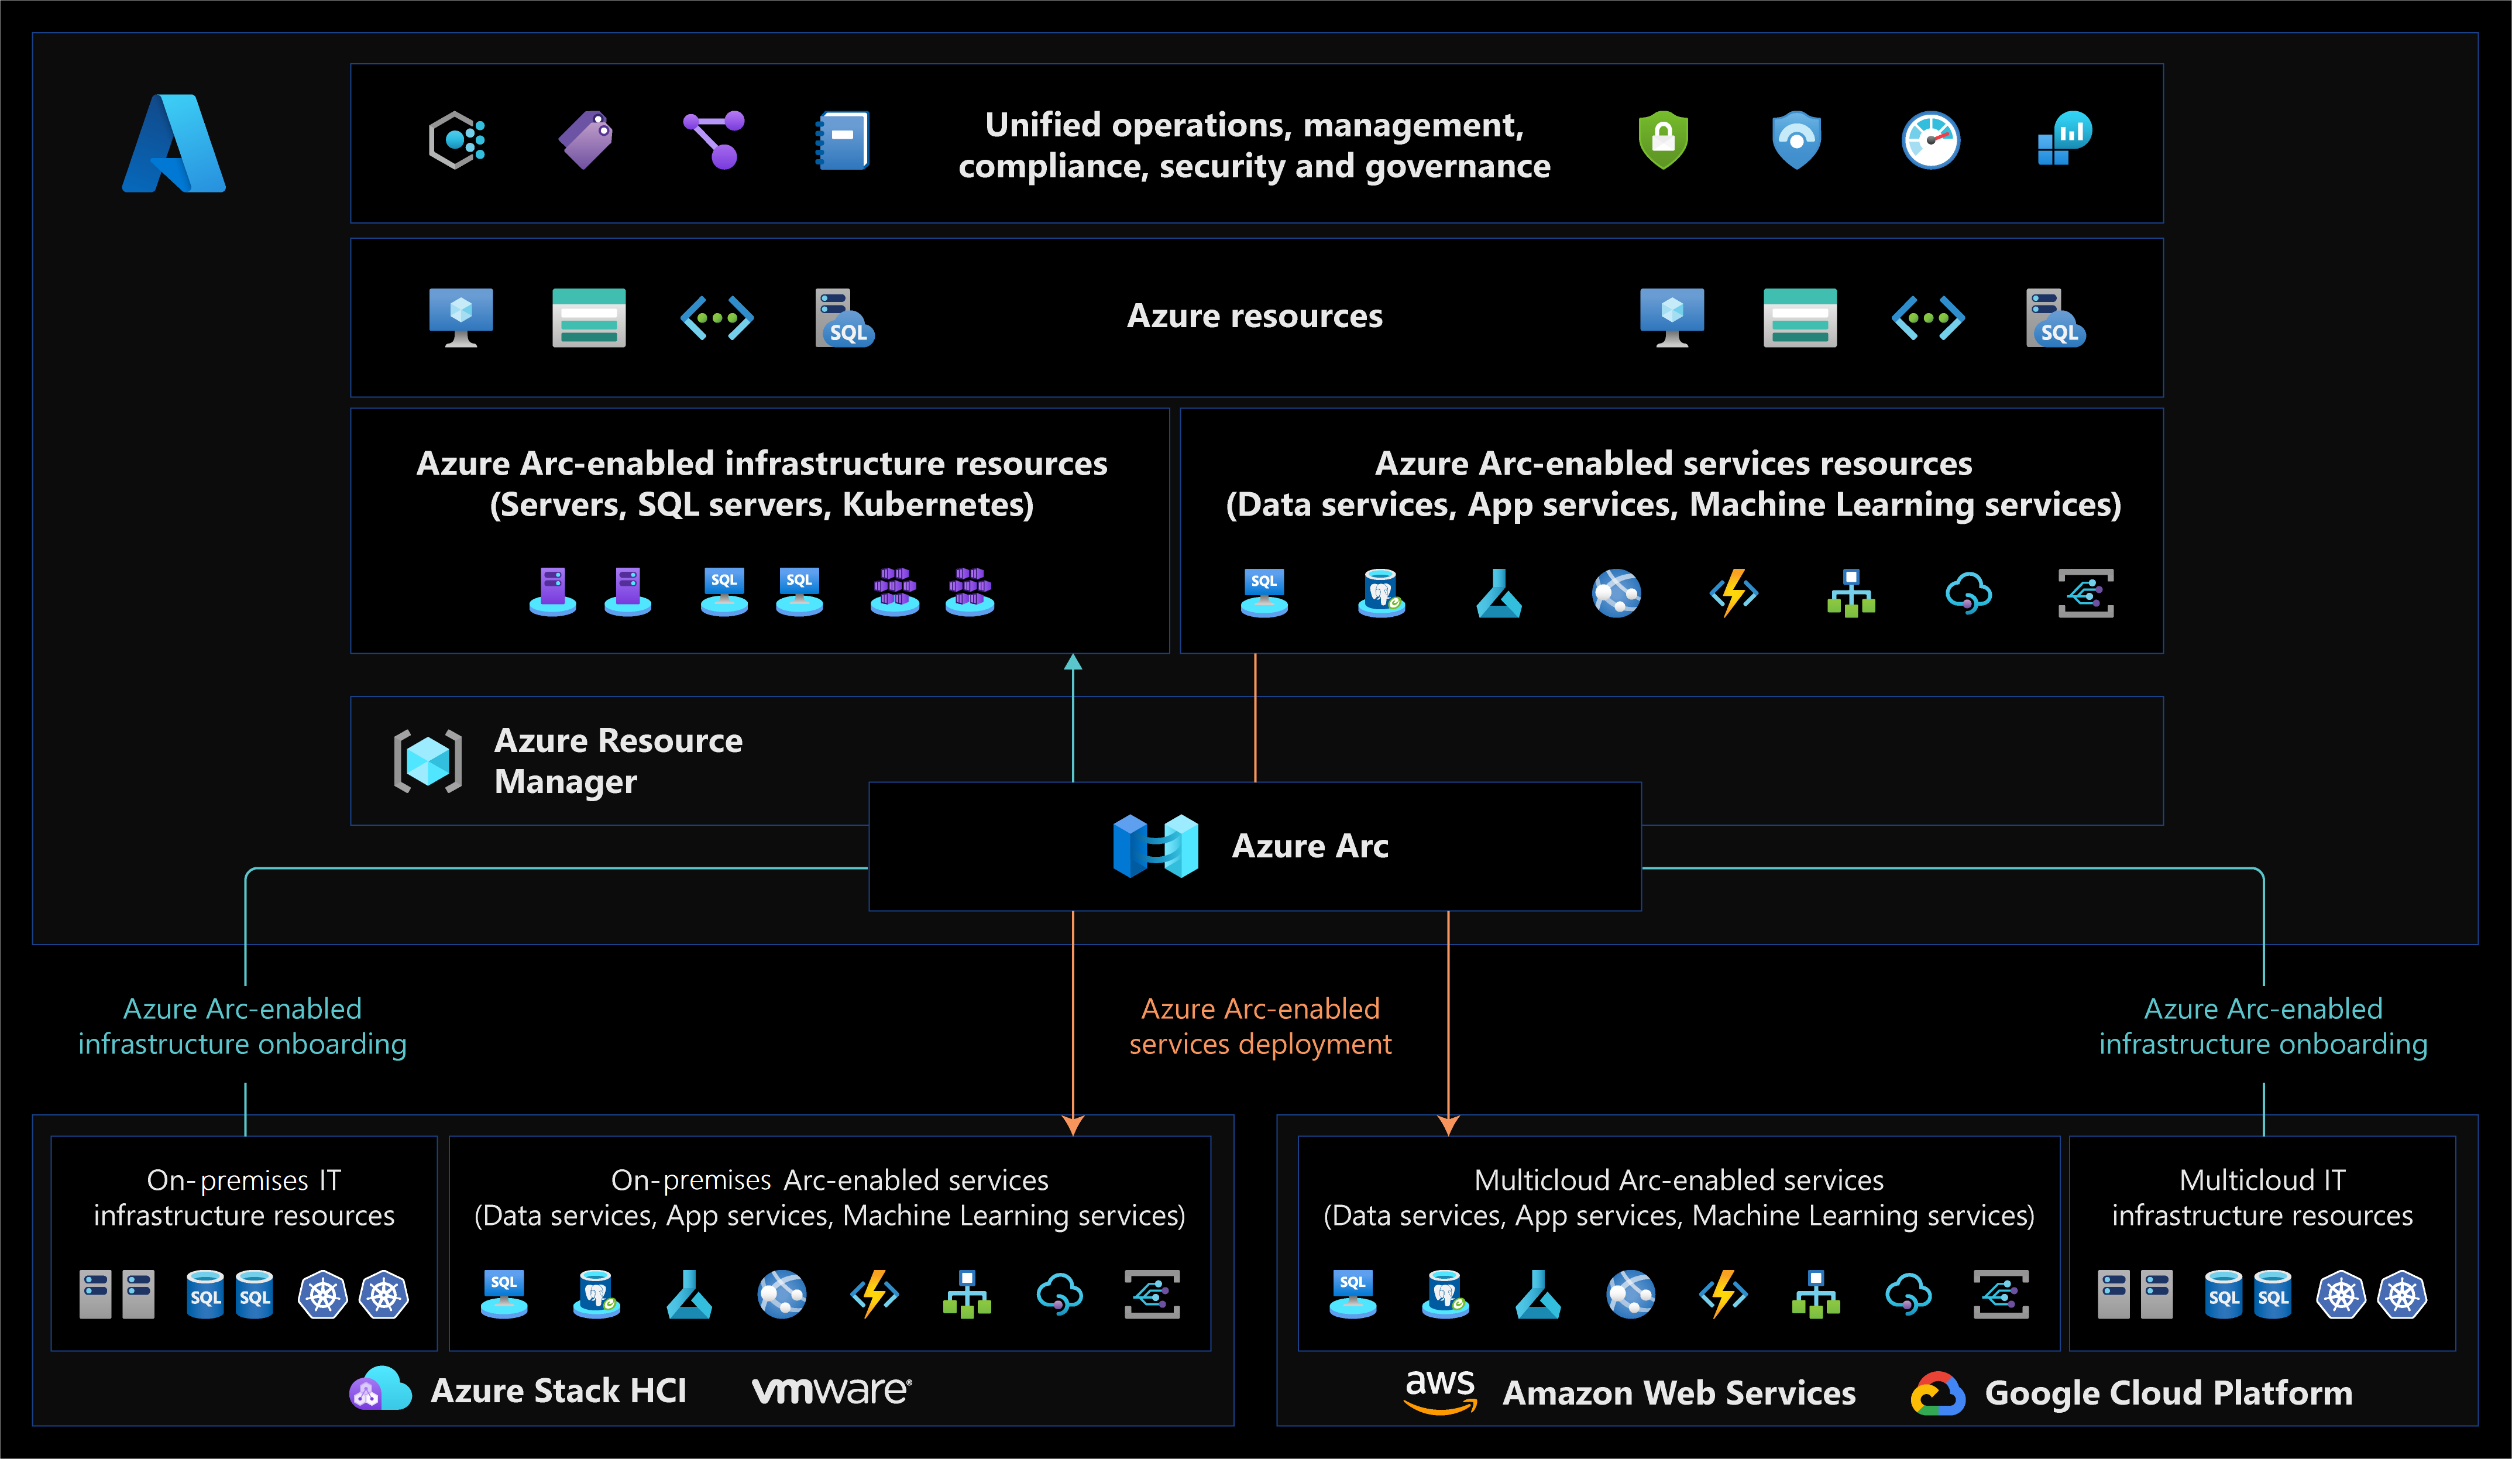
Multi-cloud Governance - Azure
Source: Azure Arc overview - Azure Arc | Microsoft Learn
Notes:
Manage your entire environment together by projecting your existing non-Azure and/or on-premises resources into Azure Resource Manager.
Manage virtual machines, Kubernetes clusters, and databases as if they are running in Azure.
Use familiar Azure services and management capabilities, regardless of where your resources live.
Continue using traditional ITOps while introducing DevOps practices to support new cloud native patterns in your environment.
Configure custom locations as an abstraction layer on top of Azure Arc-enabled Kubernetes clusters and cluster extensions.

Slide 24
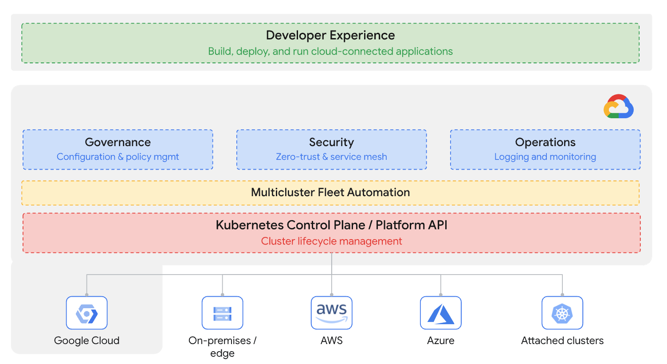
Multi-cloud Governance - GCP
Source: Anthos (GKE Enterprise) technical overview | Google Cloud
Notes:
Manage your entire environment together by projecting your existing non-Azure and/or on-premises resources into Azure Resource Manager.
Manage virtual machines, Kubernetes clusters, and databases as if they are running in Azure.
Use familiar Azure services and management capabilities, regardless of where your resources live.
Continue using traditional ITOps while introducing DevOps practices to support new cloud native patterns in your environment.
Configure custom locations as an abstraction layer on top of Azure Arc-enabled Kubernetes clusters and cluster extensions.

Slide 25
Putting it all together
Containerized apps
Microsoft Entra
Terraform
/Pulumi
MySQL/Postgresql/
MongoDB
LGTM/Open Telemetry
Defender
ACA/AKS/ECS/EKS/
GKE
Azure Arc/Anthos

Slide 26
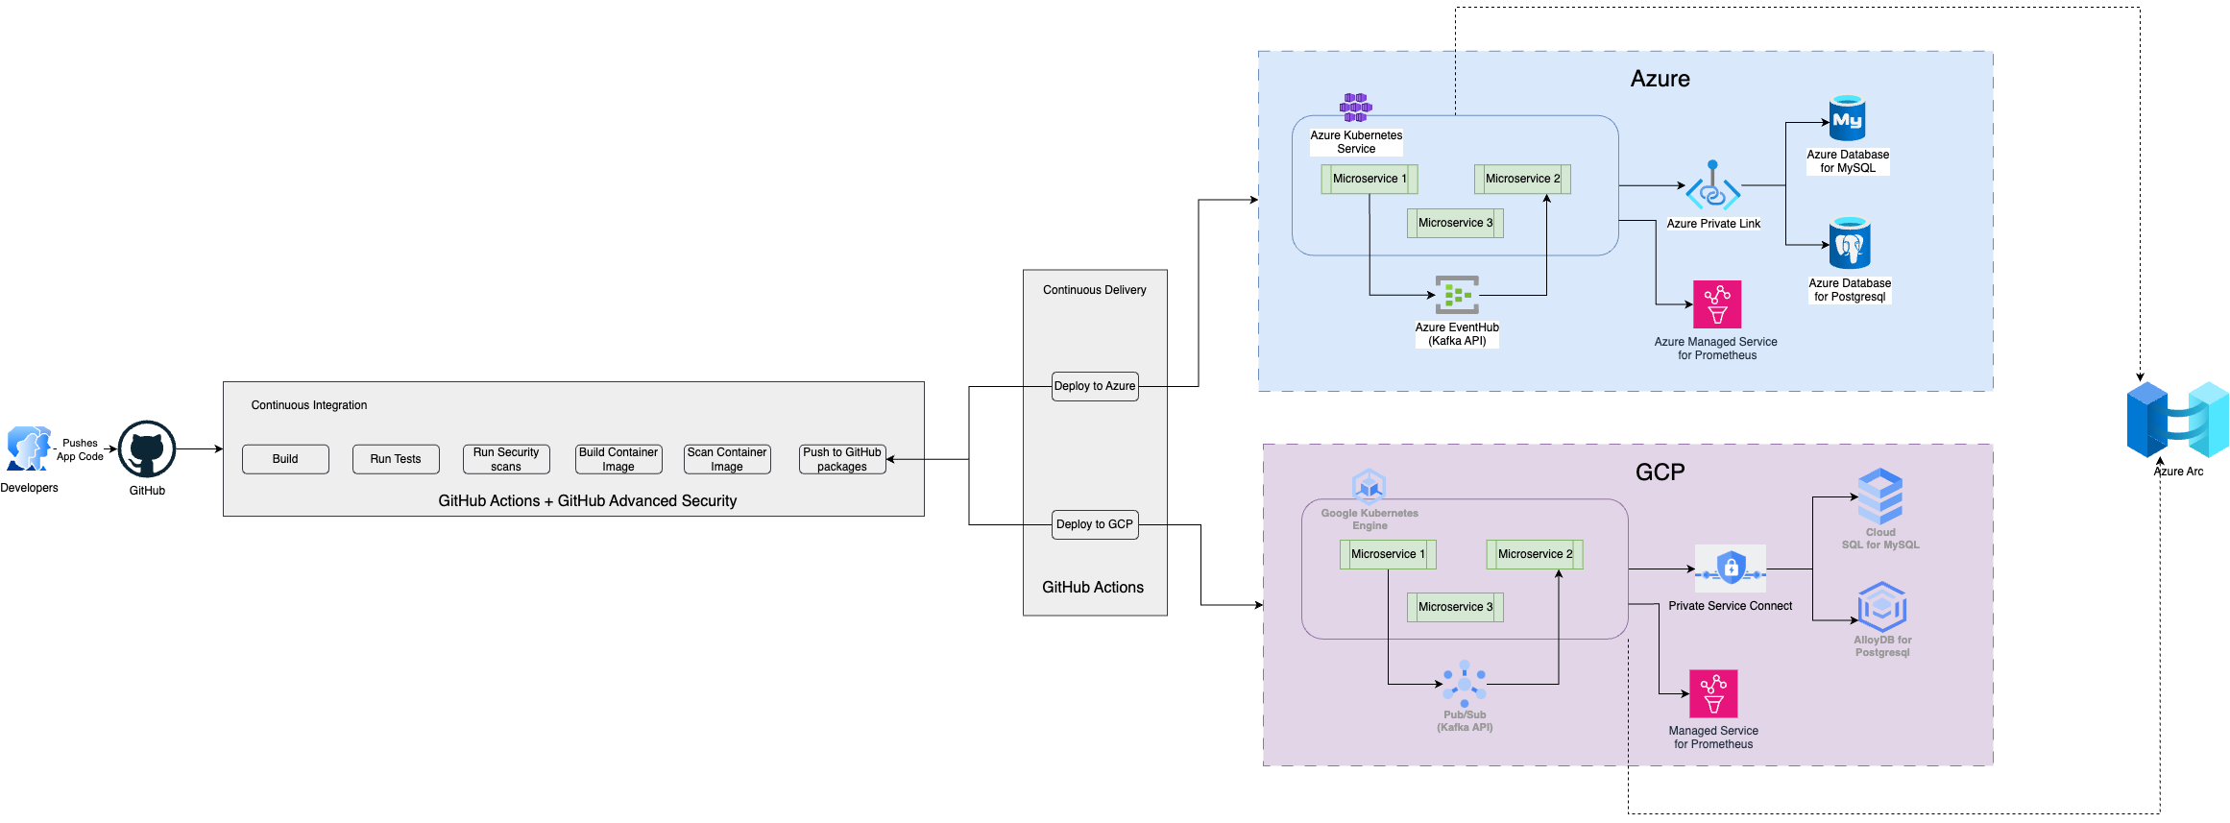
Multi-cloud architecture

Slide 27
Can’t we leverage CNCF toolset for Multi-cloud ??
Of course, Yes!!!

Slide 28
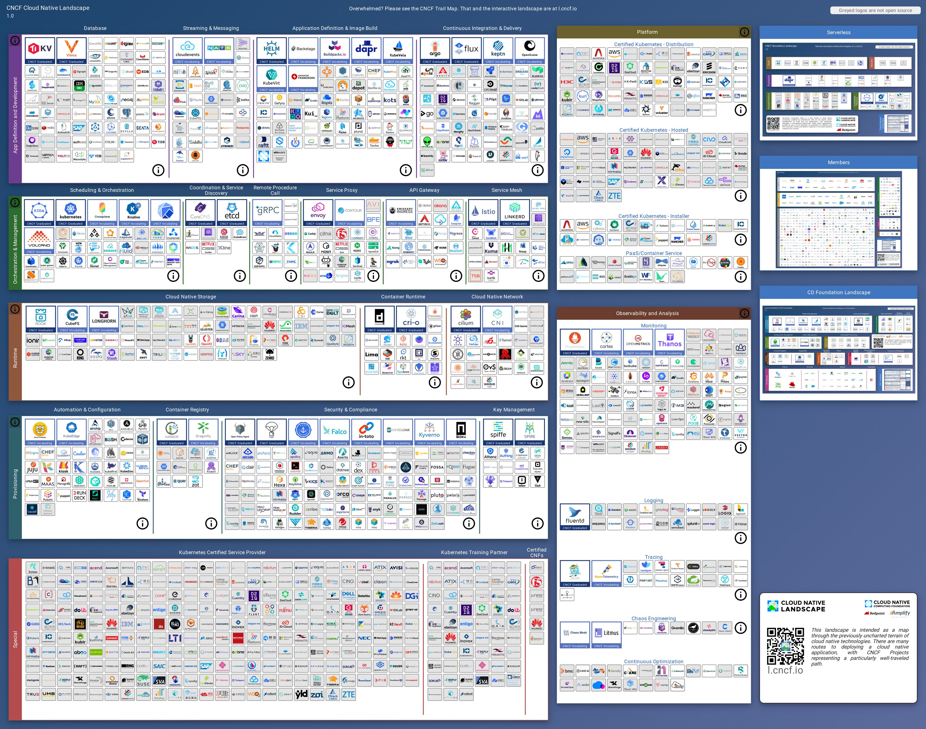
CNCF Landscape
Courtesy : landscape.png (8680×6840) (cncf.io)

Slide 29
Multi-cloud apps - Challenges
Choosing LCD from every cloud
Management Complexity (Monitoring/Operations)
Consistent Security
Integrating Software environments
Consistent performance & reliability
Consistent developer experience
Governance across multiple clouds

Slide 30
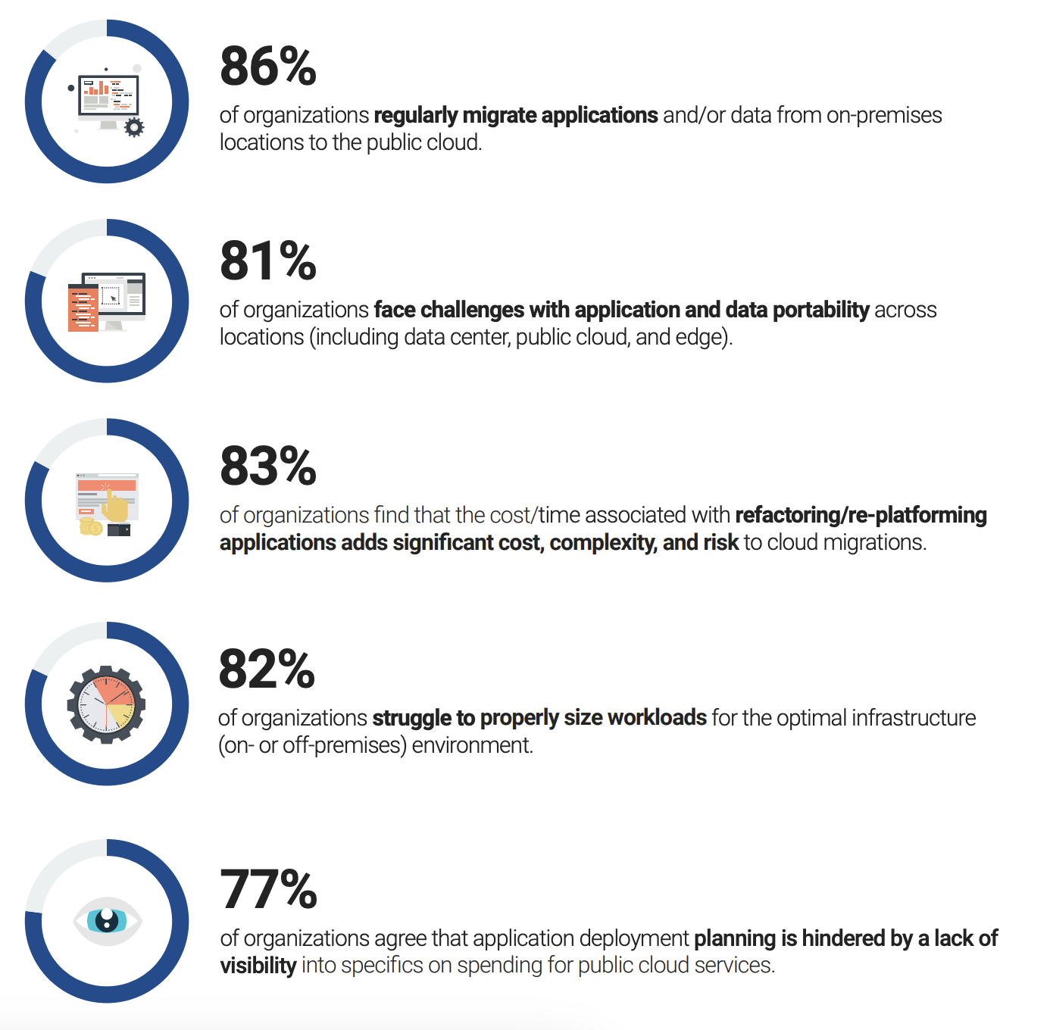
Multi-cloud challenges stats
Source: esg_ebook_google_cloud_multicloud_application_deployment_february_2023.pdf

Slide 31
To Be, or Not To Be
Why not if the business benefits outweighs challenges …

Slide 32
Multi-cloud is NOT a silver bullet
Like any other tech buzzword ☺

Slide 33
Tools & Tech to build multi-cloud apps

Slide 34
Dapr - Distributed Application Runtime
Dapr is a portable, event-driven runtime that makes it easy for any developer to build resilient, stateless, and stateful applications that run on the cloud and edge and embraces the diversity of languages and developer frameworks
Source: Overview | Dapr Docs

Slide 35
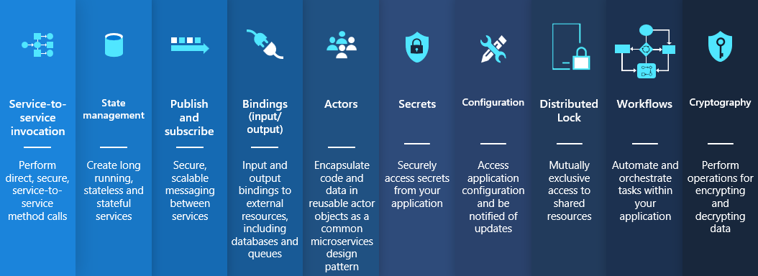
Dapr – Building Blocks
Source: docs/daprdocs/static/images/building_blocks.png at v1.12 · dapr/docs · GitHub

Slide 36
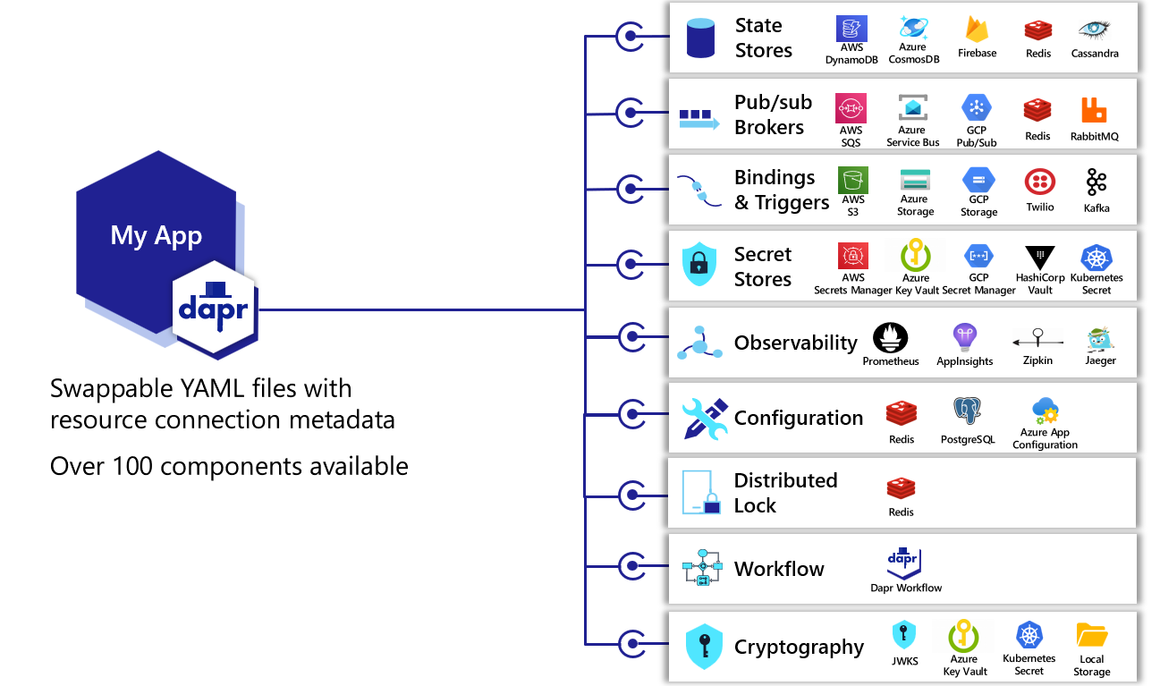
Dapr - Components
Source: docs/daprdocs/static/images/concepts-components.png at v1.12 · dapr/docs · GitHub

Slide 37
Radius
Radius is an open-source, cloud-native, application platform that enables developers and the operators that support them to define, deploy, and collaborate on cloud-native applications across public clouds and private infrastructure
**Early release and not production ready toolset
Source: Radius (radapp.io)

Slide 38
Radius - Capabilities
Developer
+
Operator Collaboration
Application Graph
Infrastructure
Recipes
Cloud Neutral
Leverage existing Toolset

Slide 39
References
Introduction to hybrid and multicloud - Cloud Adoption Framework | Microsoft Learn
What Is multicloud? Definition and benefits | Google Cloud
Cloud Native Landscape (cncf.io)
40 cloud computing stats and trends to know in 2023 | Google Cloud Blog
esg_ebook_google_cloud_multicloud_application_deployment_february_2023.pdf
Multi-Cloud: Reaching the Tipping Point (vmware.com)
Google Cloud to Azure services comparison - Azure Architecture Center | Microsoft Learn
AWS to Azure services comparison - Azure Architecture Center | Microsoft Learn
Azure Arc overview - Azure Arc | Microsoft Learn
Anthos Powers Enterprise Container Platforms | Google Cloud
Overview | Dapr Docs
Radius Docs (radapp.io)

Slide 40
Recap
Enterprises are embracing Multi-Cloud
Multi-cloud architecture is challenging and trade-offs to be carefully evaluated
Go for Multi-Cloud ONLY if the business benefits outweighs Challenges
Use Cloud agnostic services to attain multi-cloud readiness
Use CaaS over PaaS over IaaS
Containerization – most popular means; though not the only means to achieve multi-cloud

Slide 42

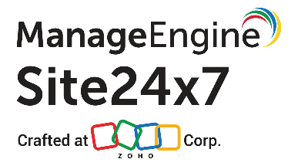
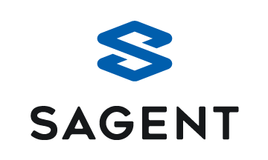

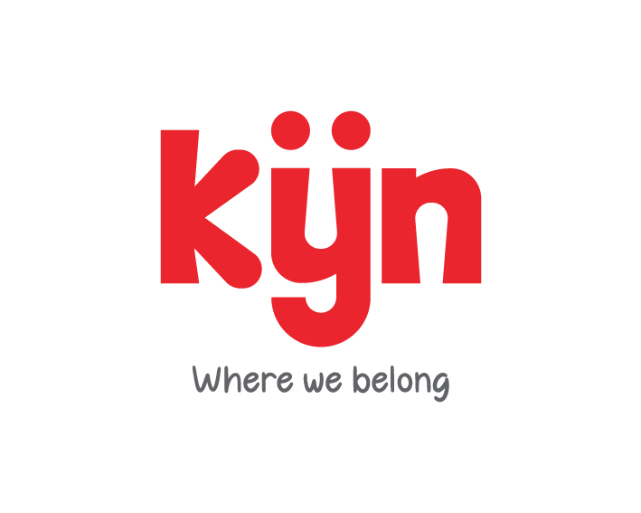


Gold Partner
Silver Partner

Slide 43
Architecting Multi Cloud Ready Applications
Swaminathan Vetri
Senior Solution Architect @ Maersk Technology Center

